Slide 1
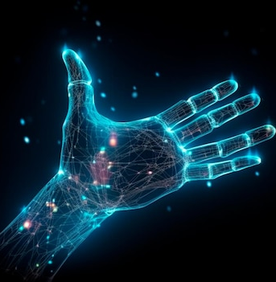
HAND GESTURE RECOGNIZITON USING DL TECHNIQUES

Slide 2
GROUP MEMEBRS
JAIDEV . K – CB.EN.U4AIE21117
SAI CHANDANA . J – CB.EN.U4AIE21118
CHARISHMA CHOWDARY . T – CB.EN.U4AIE21169
PRANISH KUMAR . M – CB.EN.U4AIE21137

Slide 3
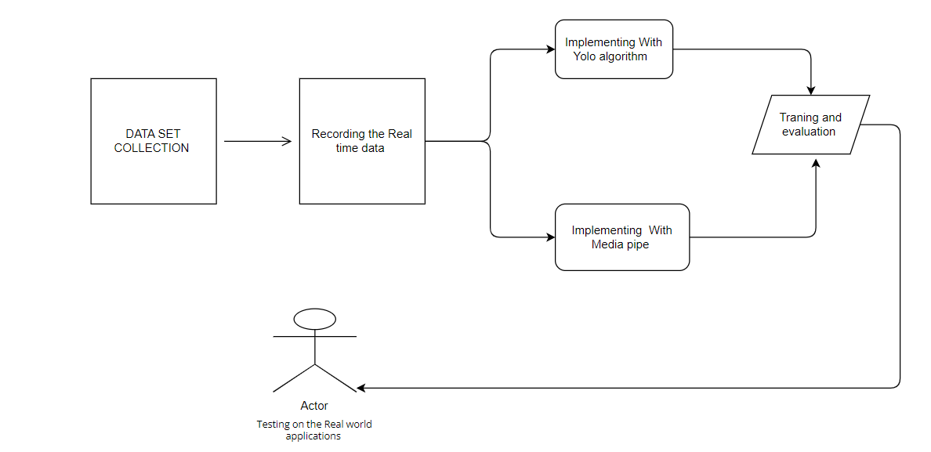
FLOW CHART / METHODOLOGY

Slide 4
WORK PROGRESS
Real-time data collection is done for our project.
Our team is divided into two groups:
1. Two members are dedicated to working with the YOLO algorithm, specifically testing its applications in real-world scenarios.
2. Another two members are focused on utilizing MediaPipe for real-world applications and testing its effectiveness.

Slide 5
Litreature Survey ​

Slide 6
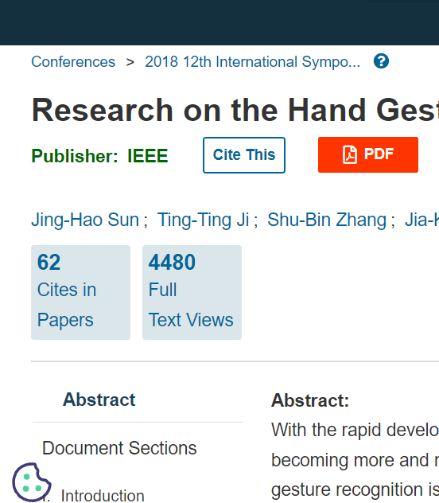
Research on the Hand Gesture Recognition Based on Deep Learning
research on hand gesture recognition based on deep learning, emphasizing the increasing demand for human-machine interaction in computer vision applications. The study focuses on segmenting hand gestures, tracking them, and using convolutional neural networks for recognition, achieving an accuracy rate of 98.3% -.
CLICK HERE TO VIEW THE RESEARCH PAPER

Slide 7
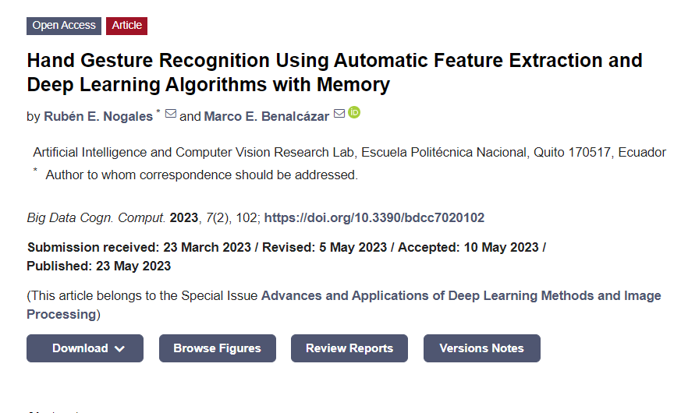
Hand Gesture Recognition Using Automatic Feature Extraction and Deep Learning Algorithms with Memory
The document discusses the importance of data quantity and quality in machine learning models, particularly in hand gesture recognition using the Leap Motion Controller. It explores manual and automatic feature extraction techniques, including CNN and BiLSTM algorithms, and evaluates their performance through classification tests and recognition accuracy.
CLICK HERE TO VIEW THE RESEARCH PAPER

Slide 8
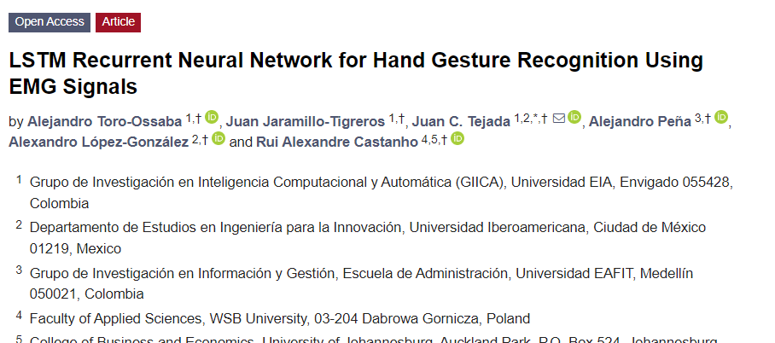
LSTM Recurrent Neural Network for Hand Gesture Recognition Using EMG Signals
The research paper at the provided link is titled "LSTM Recurrent Neural Network for Hand Gesture Recognition Using EMG Signals" and was published in the Sensors journal. The paper focuses on the use of a Long Short-Term Memory (LSTM) Recurrent Neural Network (RNN) model for hand gesture recognition using electromyography (EMG) signals. The researchers achieved an accuracy of 96.05% in their study. The approach presented in this paper demonstrates the potential of the LSTM-RNN model for non-invasive hand gesture recognition, which has numerous applications in areas such as prosthetics and human-computer interaction.
CLICK HERE TO VIEW THE RESEARCH PAPER

Slide 9
THANK YOU

